Slide 1

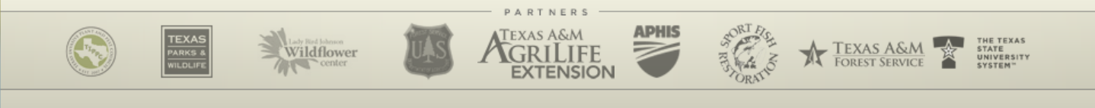
Overview/Introduction to Invasive Species
USDA-APHIS
Texas Invasive Species Institute (TISI)
SHSU Agriculture Sciences
SHSU Engineering Technology

Slide 2
TEKS / OBJECTIVES
TEKS: 130.25 4 (A-E) The student uses critical thinking, scientific reasoning, and problem solving to make informed decisions within and outside the classroom
Objectives:
The student will analyze proper methods in handling biosecurity measures in agriculture
The student will illustrate beginner knowledge of invasive species in Texas and their roles

Slide 3

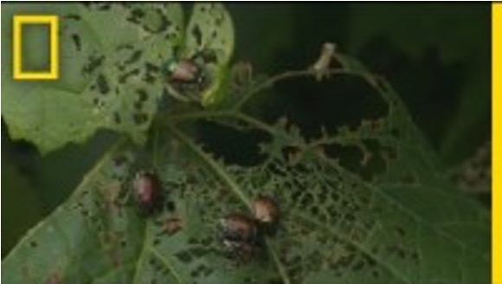
What are Invasive Species?
This video explains a beginner knowledge to Invasive Species and outside effects that they have on society.
-National Geographic
https://www.nationalgeographic.com/environment/article/invasive-species
Notes:
Link to video:
https://content.uplynk.com/ext/e6dbd32077b143a4b9cb024b791f2930/10470007.m3u8?cid=10470007&eid=de181cd3-9a20-4f73-b4b3-f2ded6485d4b&ct=a&tc=1&exp=1755802637&rn=322085168&ptid=ESPN_tvOS_VDMS&linearv=4&euid=SEC_VDMS&rays=kefgjihabc&sig=7953adb430a3a20f6832fc312992b27d1615ecb12fc29f42ae4db1f9e326c236

Slide 4
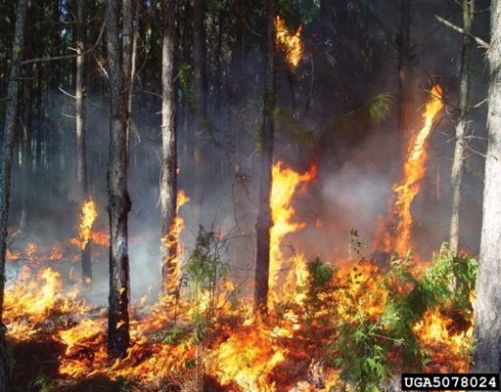
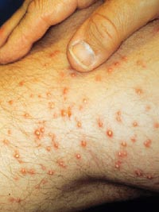
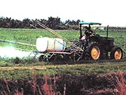
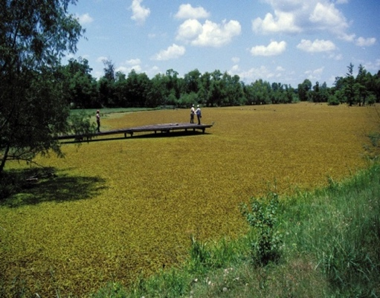
What Is an Invasive Species?
The Federal Definition
a species that is non-native (or alien) to the ecosystem under consideration and whose introduction causes or is likely to cause economic or environmental harm or harm to human health. (Executive Order 13112, 1999)
Notes:
In 1999, President Clinton issued executive order 13112, which defined an invasive species as a non-native species, whose introduction causes economic or environmental damages and may also harm human health. Many of these species fit into more than one category. For example, invasive aquatic plants may have economic impacts to fisheries but also will have social impacts by making rivers and lakes unusable for boating and swimming.

Slide 5
Invasive Species, continued
A non-native species (plant/animal/disease) that causes harm and outcompetes native species in an area.
How they outcompete:
Reproduces faster than native species (seeds/eggs/large litters)
Voracious appetite
No natural predators/consumers
More resistant to diseases and parasites
“Exotic” ≠ Invasive Species; Often? Yes! But sometimes it can be a native.
Ex: Smallmouth bass. It is native to Quebec-Oklahoma-Alabama waterways.
Spread by fisherman catching and releasing them into livable environments.
Outcompetes other native fishes because it is very predatory and even eating smaller smallmouth bass.
Now found most states except Florida and Louisiana.
Found in eastern Texas and Edwards Plateau.
Notes:
This slide helps point out how invasive species are able to takeover in native areas.
It also points out that just because a species is Exotic does not mean it’s an Invasive species.

Slide 6
Invasive Species Impacts
Human Health
Industry
Recreation
Economy
Invasive Species
Natural Heritage
Forestry
Agriculture
Notes:
Invasive species impact not only our natural heritage, but our recreation opportunities, our health, and industry, agriculture, and forestry. Together these have a major impact on the economy.

Slide 7
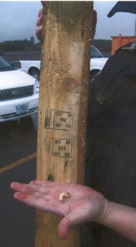
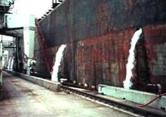
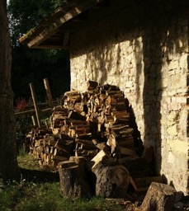
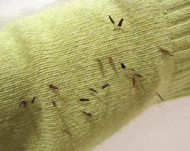
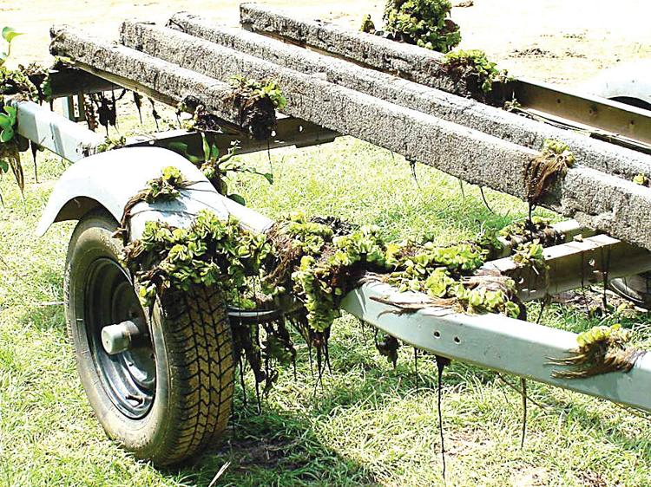
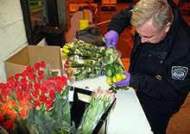
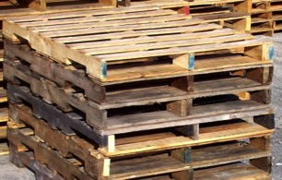
Invasive Species Spread: Accidental
Ship ballast water
Packing materials & shipping pallets
Firewood
Recreational travelers
Hay
Flowers
Mowing practices
Boats and Vehicles
Boots and gear
Notes:
As the video discussed- Human-assisted introductions can be accidental.
Species have been introduced in packing material, as crop contaminants or in the ballast of ships, or other means as in this list.
The bolded items are shown in the photos

Slide 8
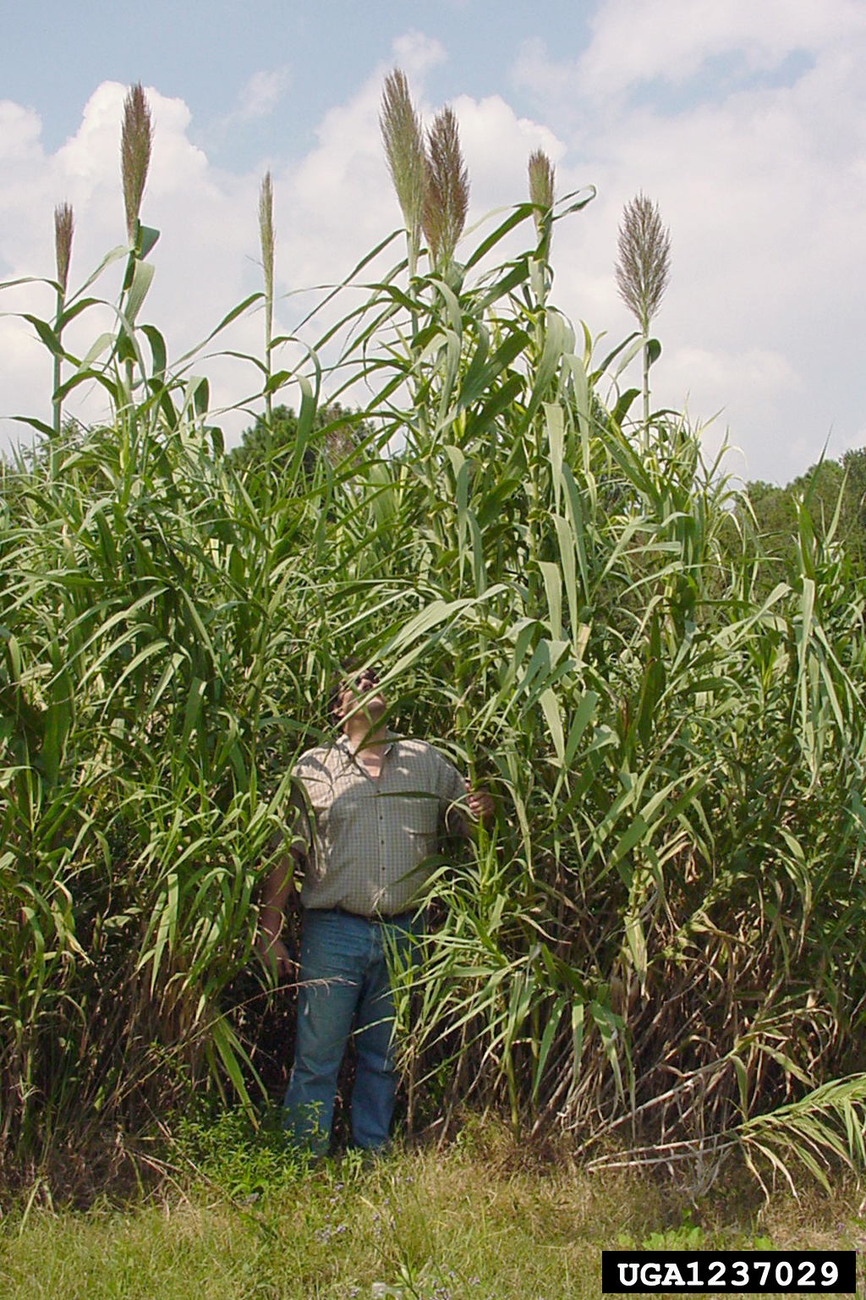
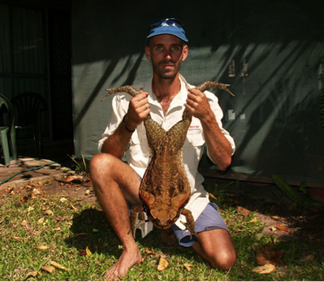
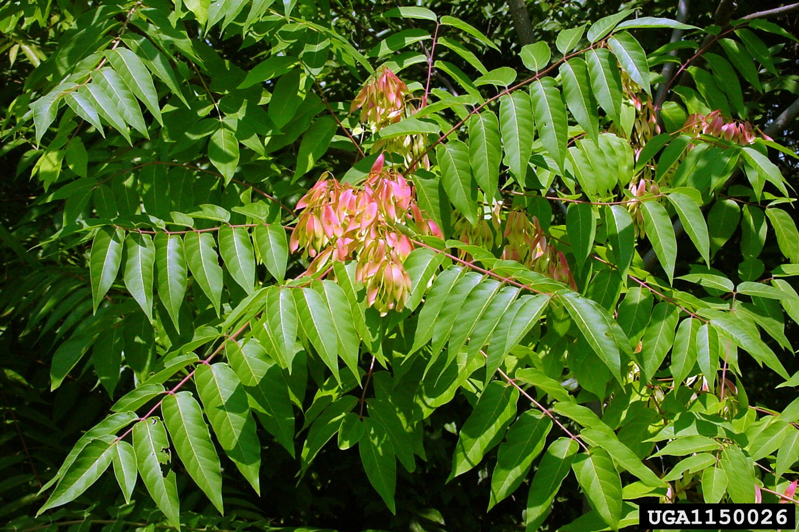
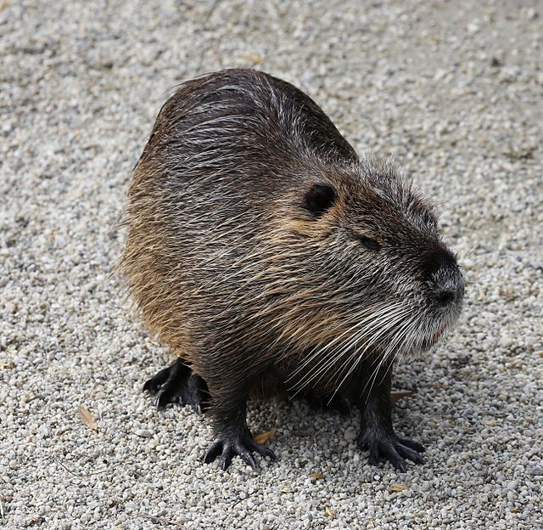
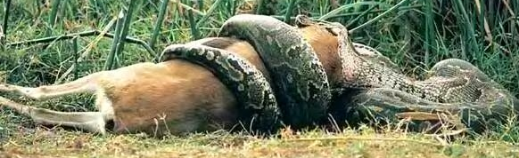
Invasive Species Spread: Purposeful
Ornamental planting
Erosion control
Agriculture/Sport/Fur
Biological Controls
Pets/Aquariums
Wildlife value
Notes:
But, many have also been introduced deliberately; some species have been brought in to control other invasive species such as Asian carp, or introduced as sport fish, as ornamental plants or released pets (python in Florida, lionfish).
Globalization and trade have allowed organisms to move from one continent to another in a matter of hours. This has always occurred, but transportation advances have sped this process up exponentially. These initial populations then have escaped into the natural environment.
Pictures: Giant Reed on roadside (brought in for erosion control); Cane Toad released as a biological control of sugar cane pests in Australia (covered in Intro Video); Tree-of-Heaven planted for Ornamental/Landscaping purposes but invades natural areas and hosts invasive insects that can spread to other native trees; Pythons dumped in Florida Everglades by irresponsible pet-owners have become TOP predators attacking alligators and deer (as pictured);

Slide 9
Why Do We Battle Invasive Species? Economic Harm
50,000 non-native species in the U.S. costs over $138 billion annually.
Examples:
Feral Animals:
cats kill approximately 465 million birds/year and cost an estimated $14 billion/year¹
$1.5 billion/yr spent to repair and prevent damage by feral hogs in the US.⁵
Invasive Exotic Pets: Control of Burmese python in Florida costs USFWS $720,000 annually²
Asian Carp Barrier: $30 million to build, $18 million/yr to maintain
Emerald Ash Borer : Cost of treatments, removal and replacement of trees in urban areas through 2019 is $10.7 billion³
Texas Invasive Aquatics: Estimates of $17 million in lost property value. Legislature has allocated $9.6 million for 2016-2017 biennium to address aquatic invasive species.⁴
¹National Invasive Species Information Center, 2006 ² USFWS, 2012 ³ Kovacs et al. 2010 ⁴ TPWD ⁵Snow et al., 2017
Notes:
Asian carp barrier on Chicago River locks: $30 mil to build, $18 mil/yr to maintain (BLM)
Texas legislature has allocated $9.6 million to address the problem of aquatic invasive species, illustrating how important this is.
Kovacs, Kent F.; Haight, Robert G.; McCullough, Deborah G.; Mercader, Rodrigo J.; Siegert, Nathan W.; Liebhold, Andrew M. 2010. Cost of potential emerald ash borer damage in U.S communities, 2009-2019. Ecological Economics 69: 569-578.

Slide 10
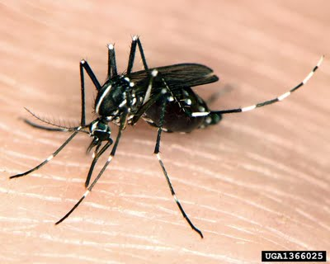
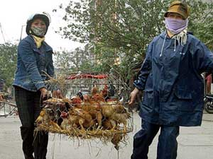
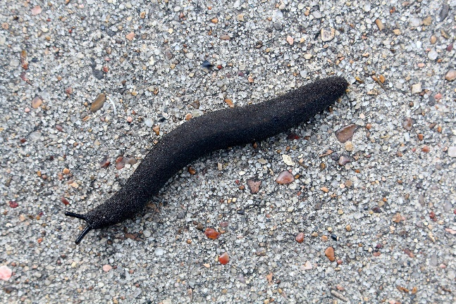
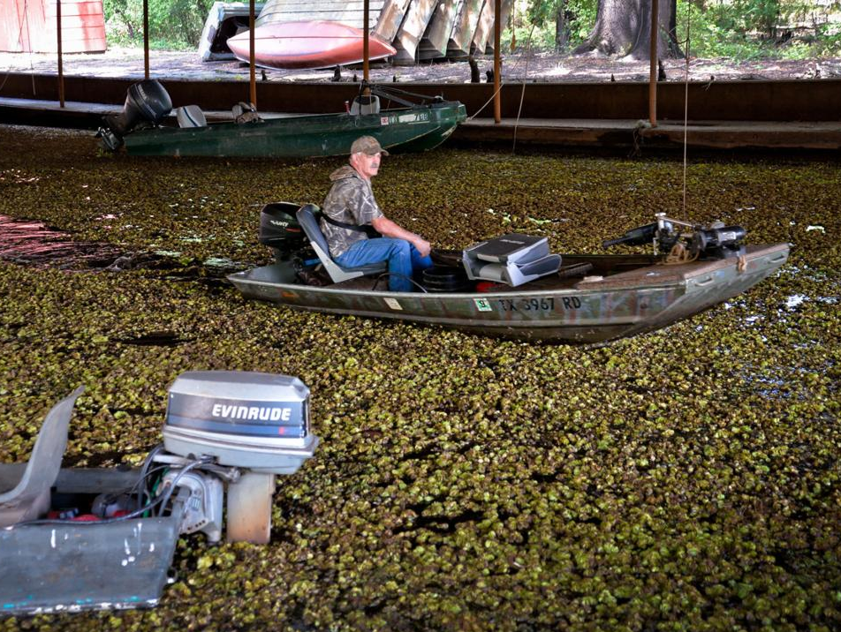
Why Do We Battle Invasive Species? Damage to Human Health & Social/Recreational
Human Health
Allergies
Pollens
Insect bites/stings
Injury/disease
SARS
West Nile virus
Parasites
Rat Lungworm
Skin rashes/burns
Pesticide/herbicide application
Social/Recreational
Sport fishing & boating
Aesthetics & Outdoor activities
International travel
2
1
3
¹alic.arid.arizona.edu/invasive/sub9/p2.shtml ²www.fredhoogervorst.com/photo/08485/ ³https://www.news-journal.com/news/local/
Notes:
There is also human health, social and recreational impacts from invasive species. Diseases like SARS and west Nile virus move globally sickening humans. Some plants species are toxic or can cause burns and blindness. Many species also sting or bite. An example is giant hogweed, whose sap causes horrible burns to skin when exposed to sunlight. Social and recreational impacts also decrease recreational access and travel.

Slide 11
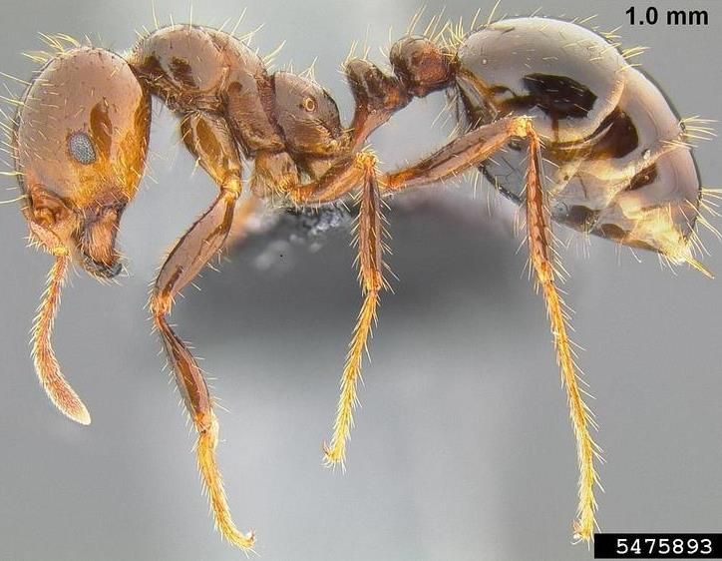
Red Imported Fire Ant (Solenopsis invicta)
Attacks native ground-dwelling animals
Harms soil arthropod community & displaces native ants
Sting can cause allergic reactions or death in humans, pets and livestock
Colonies destroy numerous crops: corn, soybean, blueberries, cabbage, etc.
Fire ants cause $500 million/year in livestock, wildlife, and public health damages and control efforts in TEXAS alone¹
¹Pimentel et al., 2000
Notes:
Environmental: Attacks native ground-dwelling animals
Harms soil arthropod community & displaces native ants
Economical: Colonies destroy numerous crops: corn, soybean, blueberries, cabbage, etc. Fire ants cause $500 million/year in livestock, wildlife, and public health damages and control efforts in TEXAS alone¹
Human & Animal Health: Sting can cause allergic reactions or death in humans, pets and livestock

Slide 12
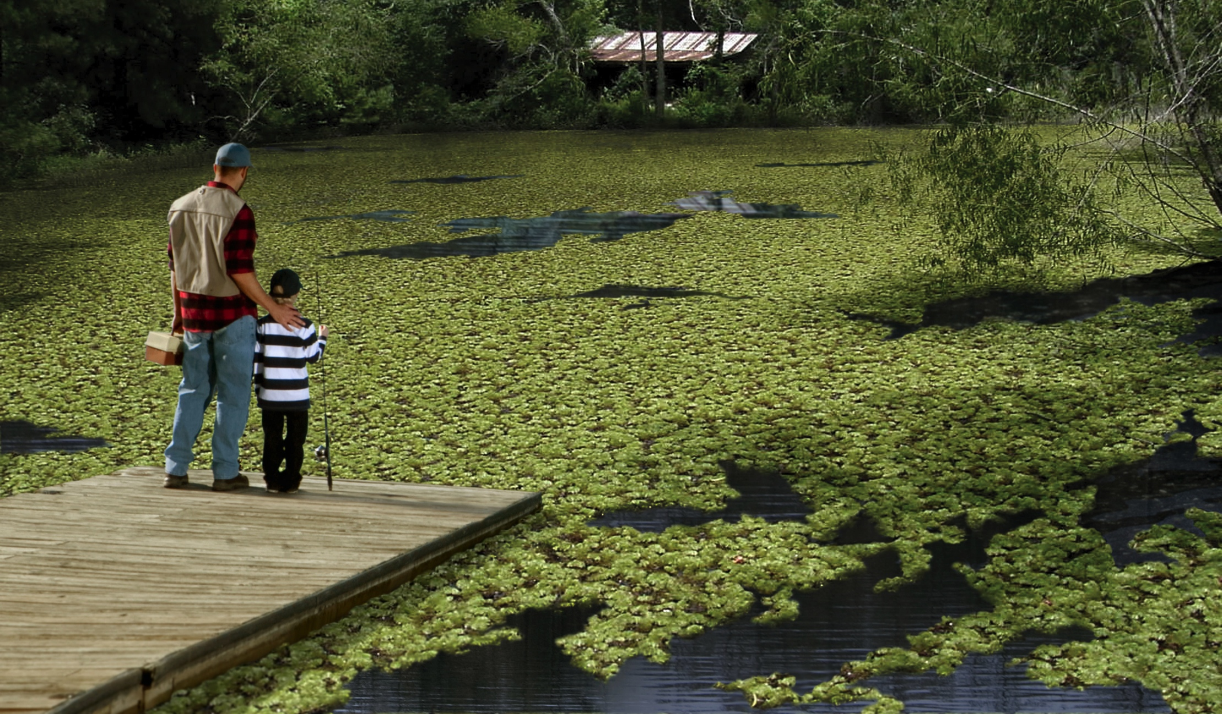
Summary slide: giant salvinia covering pond, preventing fishing.
Notes:
This picture illustrates the problem: lost recreation, ecological damage. All in one photo. Nice summary slide.

Slide 13



Notes:
Next we’ll discuss how YOU can help prevent the spread of invasives.

